Slide 1

Price Models
A framework for modeling complex prices

Slide 2

What are Price Models?
A price model represents How a price is calculated.
A Model tells the system what pricing calculation to use.
A model can query past usage when determining a price.

Slide 3
There are several pricing calculations, or strategies that can be selected. A price is calculated using a selected strategy. Past usage is queried by the system if the strategy requires it.
Strategy
Requires Usage?
Get Past Usage
Calculate a price
Metered
Graduated
Flat
Rate Card
And more…
Skip usage query if
not required.

Slide 4
Why use Price Models?
Model complex prices with a simple configuration.
Customers can build plans around items with complex prices without needing to write rules or java code.
New strategies for pricing can be quickly and easily added.

Slide 5
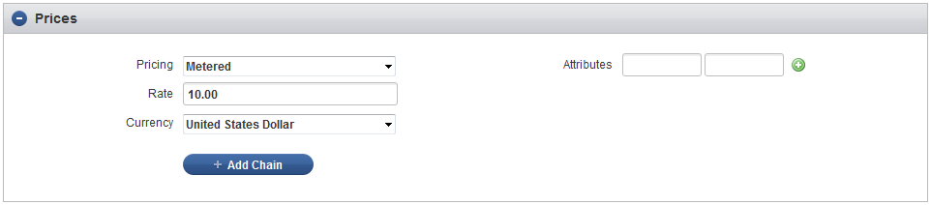
How does it work?
The pricing strategy can be set for a product.
When the product is added to an order the price is calculated using the selected strategy.

Slide 6
Flat
Metered
Each Price strategy is a stand-alone piece of code. A strategy encompasses all the logic needed to calculate a price which makes them easy to write and easy to test.

Slide 7
Quantity Add-on
Graduated
Some price models can be chained.
A chain of price modELs produces a different result than what a single entry would do on its own.

Slide 8
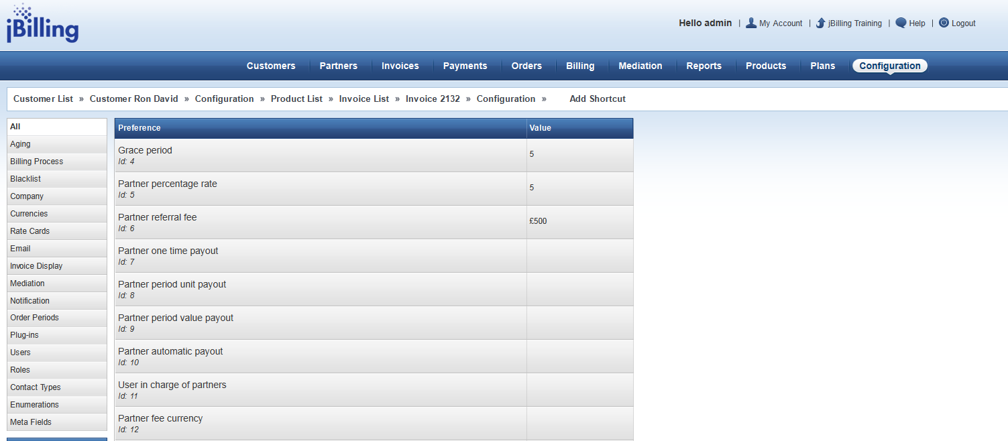
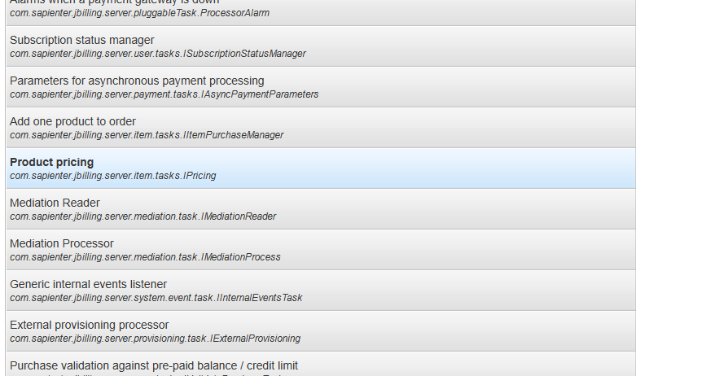
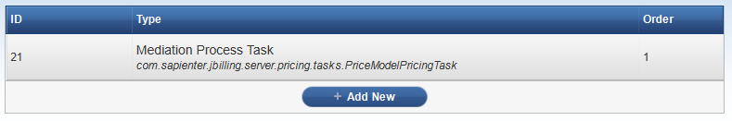
Configuring jBilling
1
A price model can only be used with the price model pricing plugin. This plug-in is responsible for running the price calculation, querying usage and producing the final price for the order.
3
2

Slide 9
The pricing plug-in can be configured to change how prices are calculated and usage is queried through parameters:
Usage_type = ‘USER’ or ‘PRICE_HOLDER’
Prices can be inherited from a sub-account. Get usage from the user owning the order or the user that holds the price?
Include_sub_account_usage = true or false
do we include usage from the customers sub-account?

Slide 10
Extension Points
Customer requirements for pricing can be met by adding new pricing strategies.
Strategies are added to the system by creating new classes that implement the pricing strategy interface.
The new price strategy can programmatically define details about it, there is no need for extra configuration data or database entries.

Slide 11
Technical Overview
You can add a new pricing strategy by:
Add a new strategy class
List the new strategy in the price model strategy enum
Add a grails UI template to display in the application

Slide 12
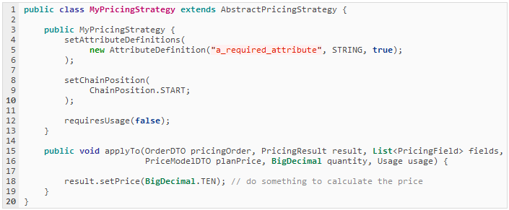
Step 1: Add a strategy class
A new strategy should extend from AbstractPricingStrategy
applyTo() should calculate the price and set PriceResult price

Slide 13
Attribute Definitions:
Your price strategy can define required attributes as "attribute definitions". The attribute definition specifies the name of the attribute, the data-type and if it's required.
Chain Position:
The chain position defines where this particular price strategy can appear in a chain. Some price strategies (such as percentage) should only be used at the end of a chain, others only at the start.
Requires Usage:
If set to true, the past "Usage" for the product being purchased will be counted and passed into the applyTo() method.

Slide 14
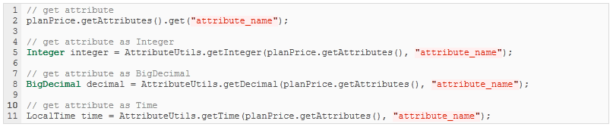
Attribute values are passed into the apply to method as part of the original price model object.
You can use the attribute utils class to parse attributes as a specific data type or just access them.

Slide 15
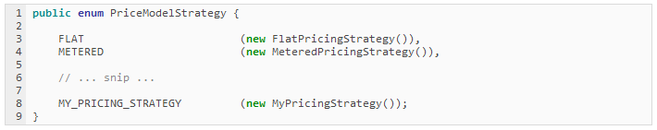
Step 2: Update the strategy enum
Add a new entry to the PriceModelStrategy enum, this gives your strategy a name and makes it usable in a Price Model

Slide 16
Step 3: UI Template
Templates live in grails-app/view/priceModel/strategy/
The enum name is converted to ‘camelCase’ and used for determining the name of the UI template
PriceModelStrategy.METERED
PriceModelStrategy.MY_PRICING_STRATEGY
_metered.gsp
_myPricingStrategy.gsp

Slide 17
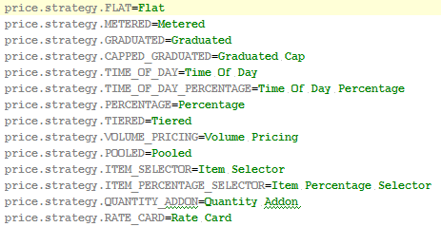
i18n
In the messages.properties file look for the line:
price.strategy.
There add a new entry following this pattern:
price.strategy.MY_PRICING_STRATEGY
So it’s the same name you used in the enum.

Slide 18
Resources
wiki: https://pm.jbilling.com/projects/jbilling/wiki/Price_Models
Review the code of other implementations. It’s always helpful

Slide 19
Excercise
Create a new price model that gives you the possibility to set a percentage value for different countries. Then the price will be incremented by applying this value.
You can have static attributes for the countries or use the dynamic attributes fields key/value.
Also set one as default.

